Slide 1
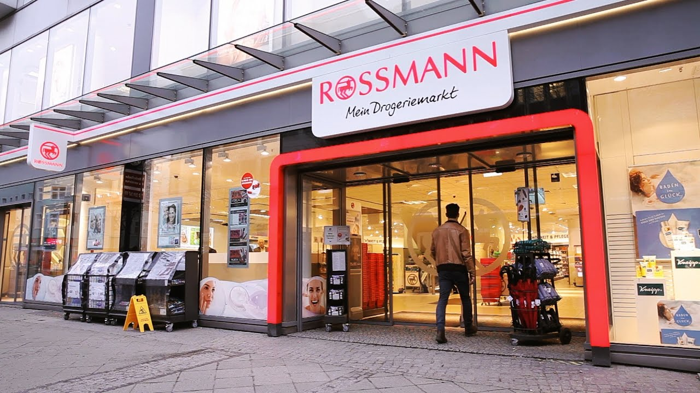
PROJECT ON PHARMACEUTICAL SALES PREDICTION ACROSS MULTIPLE STORES
NAME: S. SUJANA KUMARI
AFFILIATION: DIGICROME ACADEMY

Slide 2
PROJECT OVERVIEW
Project Scenario:
Rossmann Pharmaceuticals needs a robust sales forecasting tool to accurately predict sales across all its stores six weeks in advance. The finance team relies on these forecasts for budgeting and planning, while store managers traditionally depend on experience and intuition. With numerous factors impacting sales, such as promotions, holidays, competition, and seasonal trends, Rossmann requires a data-driven solution to support more accurate and standardized predictions across stores.
Project Description:
As a Machine Learning Engineer at Nexthikes, my role is to design and deploy an end-to-end sales forecasting solution for Rossmann Pharmaceuticals. The solution will analyze historical sales data and key influencing factors, producing six-week-ahead sales forecasts for each store. This tool will empower the finance team with timely, precise sales projections and allow analysts to easily visualize and download data for further insights. The project will ultimately improve sales predictability across Rossmann’s network and support better planning at both store and corporate levels.

Slide 3
DATA DESCRIPTION
SOURCE OF MOBILE DATA: The data used for the analysis is provided by Next Hikes.
FEATURES/VARIABLES INCLUDED: There are around 55 features and variables included in the data. The most common and important variables include Experience Score, Engagement Score and Satisfaction Score etc.
DATA SIZE AND FORMAT: The dataset includes store-specific details, promotions, holidays, customer count, and competitor information, all crucial for forecasting sales.
NECESSARY LIBRARIES TO BE IMPORTED:
Jupyter notebook and VS Code.
Technical Skills: Pandas, Matplotlib, Numpy, HTML and CSS ,
Flask.
Creation of new features
Predictive pipeline: Exploratory data analysis, data wrangling, building and
fine-tuning models
Building model using MLOps Techniques

Slide 4
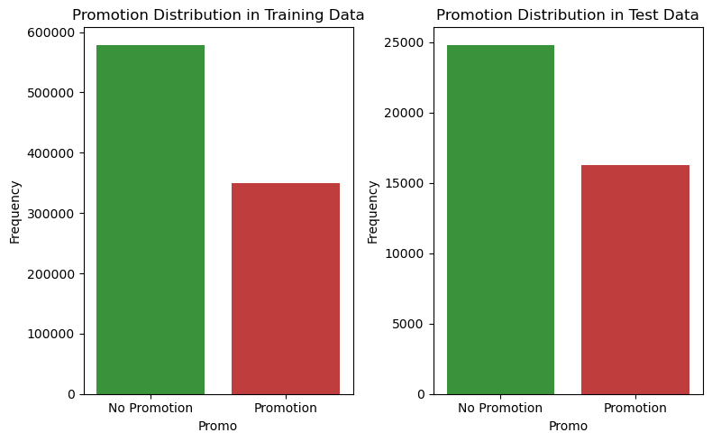
Task 1 – EXPLORATION OF CUSTOMER PURCHASE BEHAVIOUR
Check for distribution in both training and test sets- are the promotions distributed similarly between these two groups?
INTERPRETATIONS:**
Based on the bar graphs above, it appears that the distribution of promotions is quite similar between the training and test sets. Here’s a more detailed interpretation:
This similarity in distribution suggests that the promotion data is balanced between the training and test sets, which is crucial for ensuring that the machine learning model can generalize well and is not biased due to an uneven distribution of promotions.
IN SIMPLE: The similar distribution of promotions in both the training and test sets means that the data is balanced. This helps your machine learning model work well and avoid bias.

Slide 5
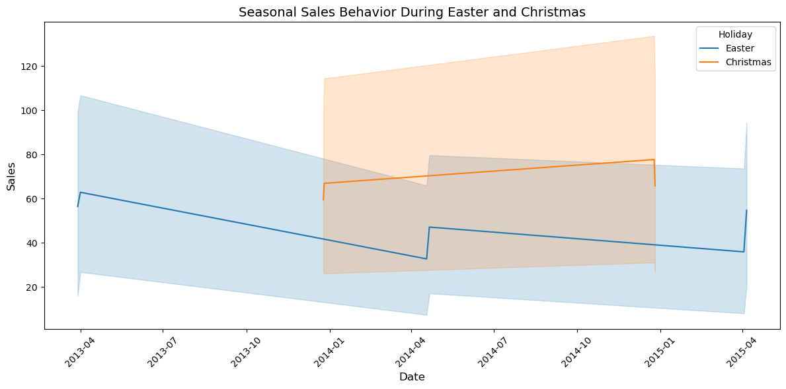
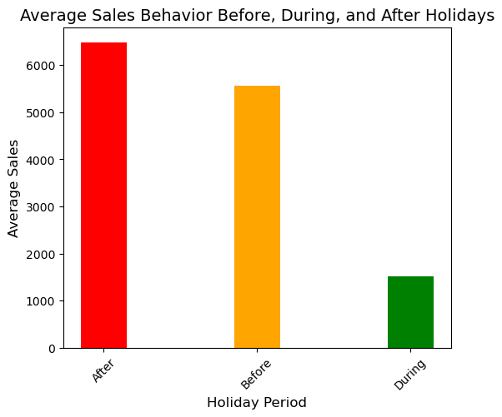
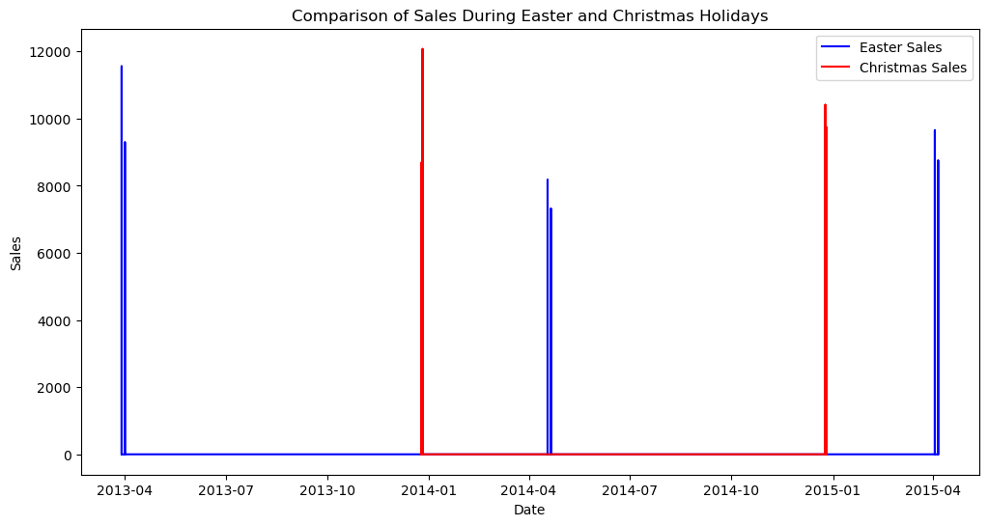
Task 1 – EXPLORATION OF CUSTOMER PURCHASE BEHAVIOUR
Check & compare sales behavior before, during and after holidays
INTERPRETATIONS: Overall, the data suggests that pharmaceutical sales are highest before the holidays, likely due to consumers preparing in advance, and then decrease during the holidays as some stores might be closed and some stores might have stores opened for only few hours, and further increase after holidays that means the sales is picking up and coming back to normal.
Find out any seasonal (Christmas, Easter etc) purchase behaviours

Slide 6
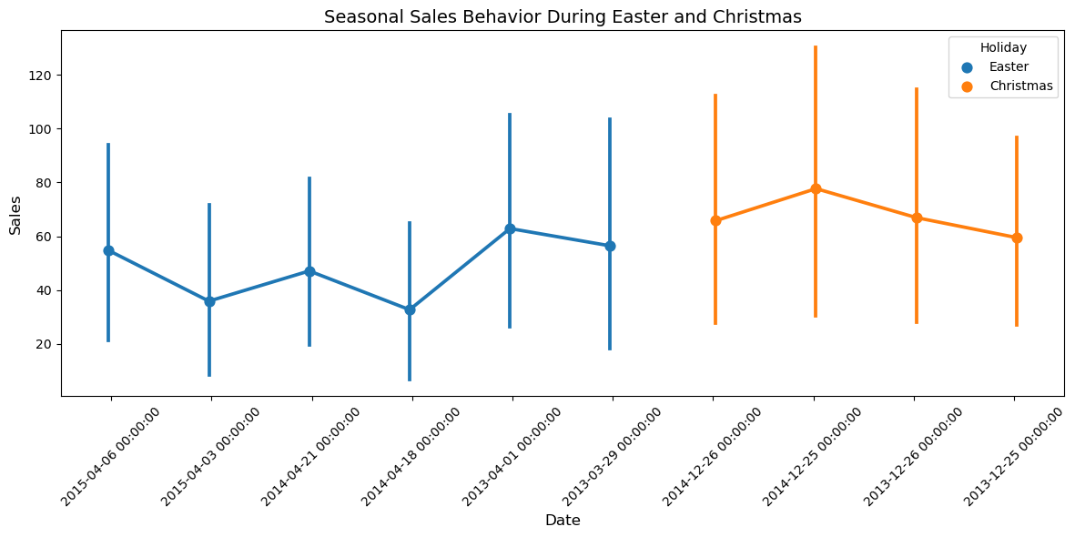
Task 1 – EXPLORATION OF CUSTOMER PURCHASE BEHAVIOUR
Find out any seasonal (Christmas, Easter etc) purchase
behaviours
INTERPRETATIONS:
Christmas Season (Orange): The orange-shaded area represents the Christmas season, which typically falls in December. The sales data exhibits a significant increase during this period, with a peak in December. This suggests that pharmaceutical sales tend to surge during the Christmas season, possibly due to:
1. Increased demand for cold and flu medications during the winter months.
2. Higher sales of health and wellness products as people prepare for the holiday season.
3. Gift purchases or stocking up on medications before the year-end.
Easter Season (Blue):The blue-shaded area represents the Easter season, which typically falls in March or April. The sales data shows a smaller, yet still noticeable, increase during this period. This might be attributed to:
1. Increased demand for allergy medications during the spring season.
2. Sales of health and wellness products related to spring-related activities (e.g., outdoor activities).

Slide 7
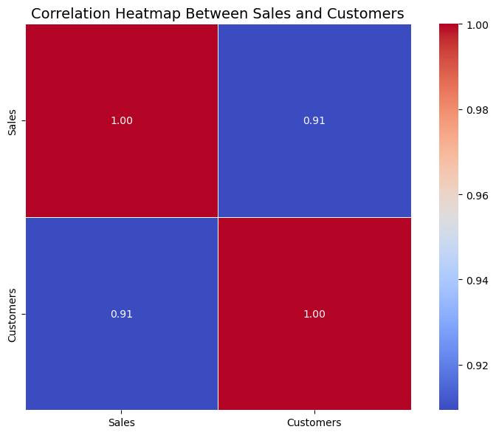
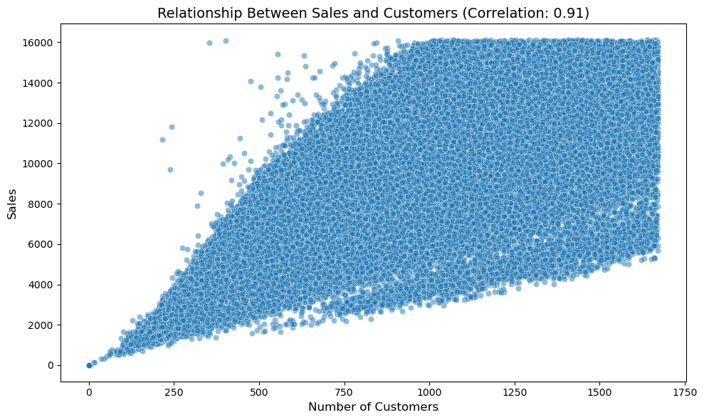
TASK 1- USER OVERVIEW ANALYSIS
What can you say about the correlation between sales and number of customers?
INTERPRETATION:
The correlation coefficient of 0.91 between Sales and Customers indicates a strong positive relationship. This means that as the number of customers increases, sales are also likely to increase significantly, and vice versa.
This information can be very useful for businesses to predict sales trends based on customer data.

Slide 8
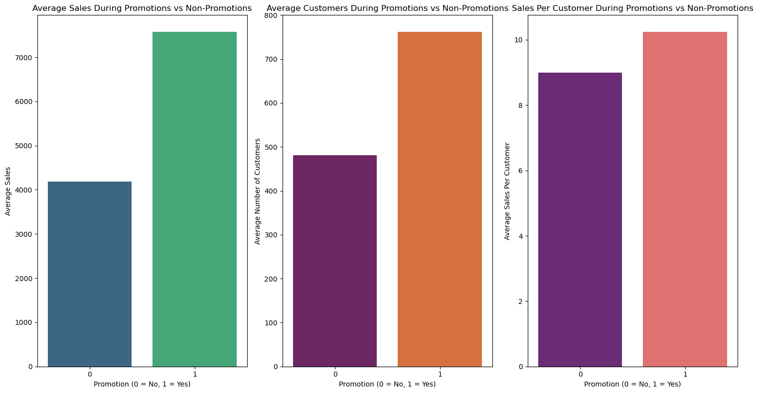
Task 1 – EXPLORATION OF CUSTOMER PURCHASE BEHAVIOUR
How does promo affect sales? Are the promos attracting more customers? How does it affect already existing customers?

Slide 9
Task 1 – EXPLORATION OF CUSTOMER PURCHASE BEHAVIOUR
How does promo affect sales?
**Promotions significantly increase sales.** The "Average Sales During Promotions vs Non-Promotions" plot clearly shows a much higher average sales figure when promotions are running. This strongly suggests that promotions are effective at driving revenue.
**Are the promos attracting more customers?**
**Yes,** promotions appear to be attracting more customers. The "Average Customers During Promotions vs Non-Promotions" plot indicates a higher average number of customers during promotional periods. This suggests that promotions are successful in bringing in a larger customer base.
**How does it affect already existing customers?**
**Promotions likely encourage higher spending per existing customer.** The "Sales Per Customer During Promotions vs Non-Promotions" plot reveals a higher average spend per customer when promotions are active. This indicates that promotions not only attract new customers but also incentivize existing customers to purchase more.

Slide 10
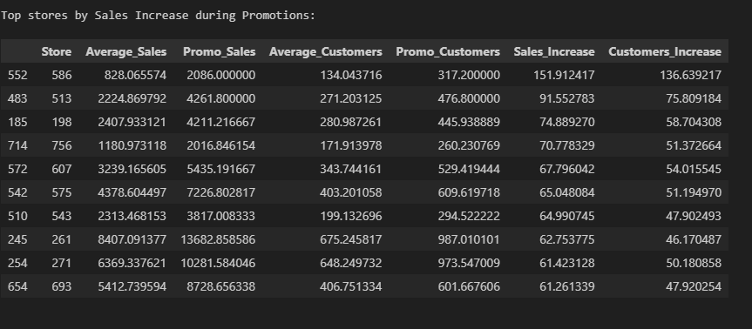
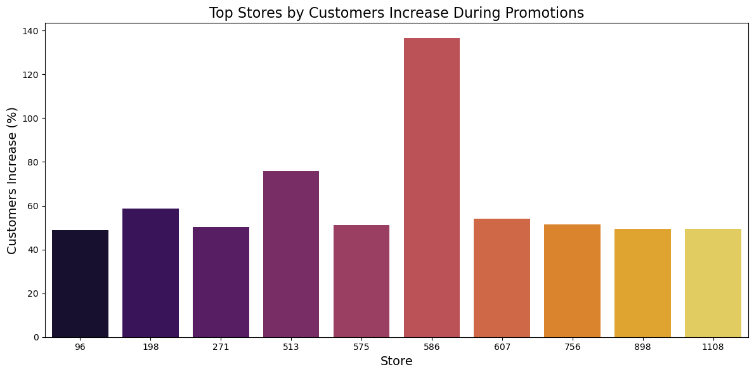
Task 1 – EXPLORATION OF CUSTOMER PURCHASE BEHAVIOUR
# Could the promos be deployed in more effective ways? Which stores should promos be deployed in? # Analyze Sales Performance During Promotions.

Slide 11
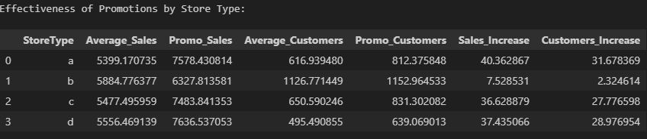
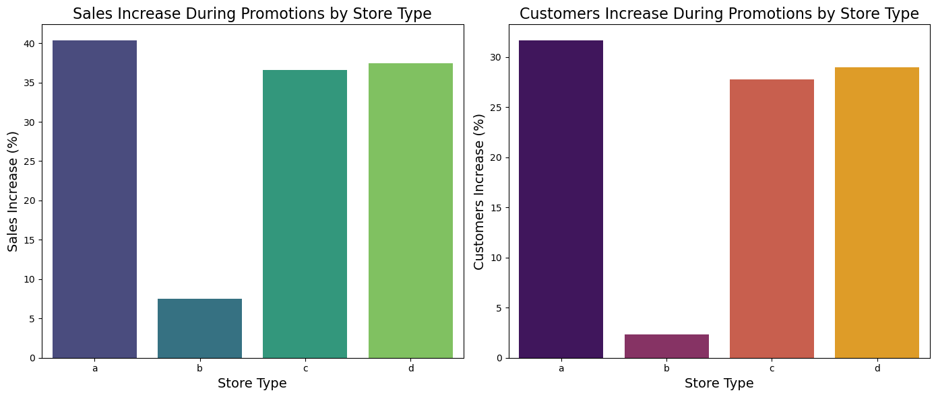
Task 1 – EXPLORATION OF CUSTOMER PURCHASE BEHAVIOUR
Effectiveness of Promotions by Store Type

Slide 12
Task 1 – EXPLORATION OF CUSTOMER PURCHASE BEHAVIOUR
Effectiveness of Promotions by Store Type
Interpretation of the Plots:***Sales Increase During Promotions:**Store Type 'a' has the highest sales increase at around 40%. Store Type 'c' and 'd' have similar sales increases of approximately 30%. Store Type 'b' has the lowest sales increase during promotions, around 10%.
Customers Increase During Promotions: Store Type 'a' also shows the largest increase in customers during promotions, around 30%. Store Type 'c' and 'd' follow, with customer increases of approximately 25% and 30%, respectively.
3. Store Type 'b' again has the lowest customer increase, with less than 10%.
Can promotions be deployed in more effective ways?**
**SUMMARY:**
In summary, promotions are most effective in store types 'a', 'c', and 'd', and these should be the primary focus for future promotional activities. Store type 'b' should either be given a tailored approach or deprioritized based on the current data."

Slide 13
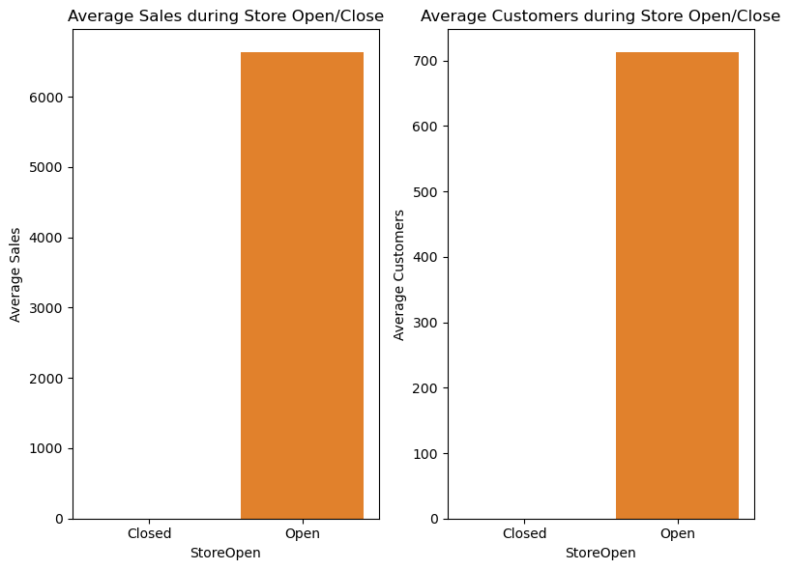
Task 1 – EXPLORATION OF CUSTOMER PURCHASE BEHAVIOUR
● # Trends of customer behavior during store open and closing times.
**Key Insights:**
Clear Correlation: There is a direct correlation between store opening times and both sales and customer activity. When the store is open, both sales and customer counts are significantly higher.
2. No Activity During Closure: As expected, there are no sales or customer activity when the store is closed.

Slide 14

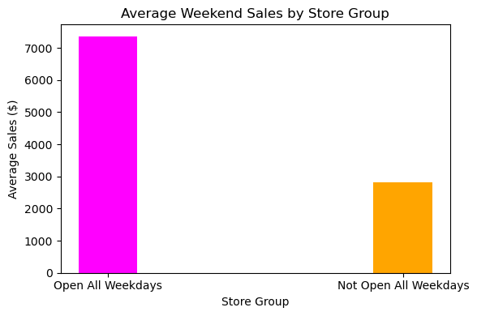
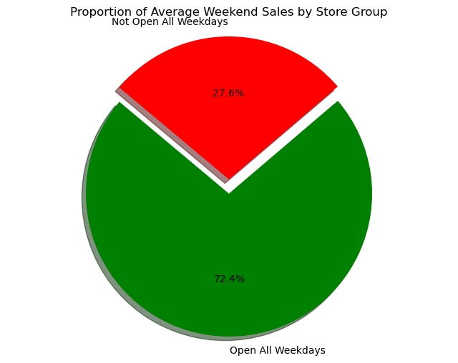
Task 1 – EXPLORATION OF CUSTOMER PURCHASE BEHAVIOUR
# Find Stores Open on All Weekdays:
**Interpretation:**
The analysis reveals a significant difference in average weekend sales between two groups of stores:
**1. Stores Open All Weekdays:**
These stores have an average weekend sales figure of approximately $7359. This suggests that consistent weekday operations contribute to higher customer familiarity and loyalty, which may translate into better sales on weekends.
2. Stores Not Open All Weekdays:**
In contrast, stores that do not operate all weekdays have an average weekend sales figure of about $2,811. This lower sales average could indicate that limited operational days lead to reduced customer engagement or lower brand visibility, resulting in fewer sales during weekends.
Overall, the data suggests that stores with regular hours throughout the week likely cultivate a stronger customer base, which positively affects their weekend performance.

Slide 15

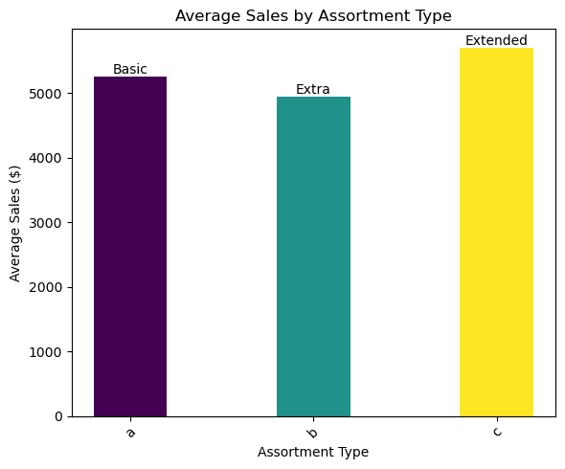
Task 1 – EXPLORATION OF CUSTOMER PURCHASE BEHAVIOUR
# Check how the assortment type affects sales
**Interpretation:**
**Assortment Type ‘a’ Basic:** This type has average sales of approximately.
**Assortment Type ‘b’ Extra:** This type shows the lowest average sales.
**Assortment Type ‘c’ Extended:** This type has the highest sales.
From this we can see that assortment type ‘c’ that is the Extended type is the most successful in terms of average sales, while type ‘b’ that is extra type has the least average sales.

Slide 16
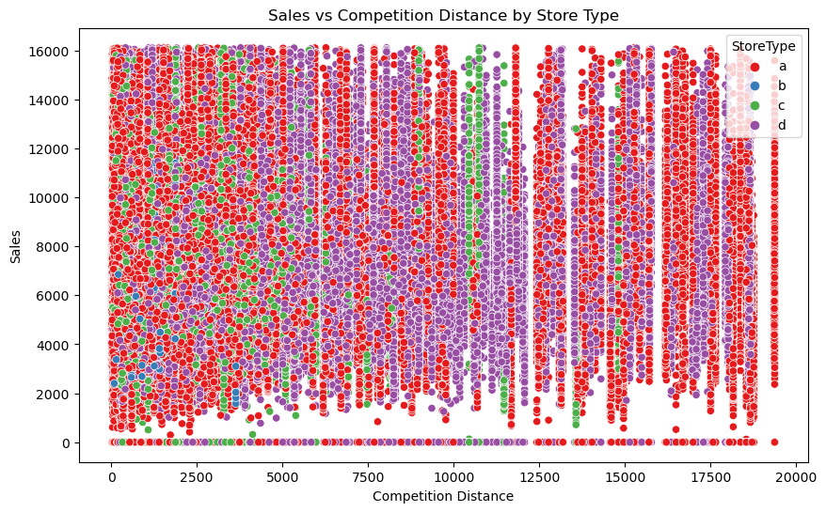
Task 1 – EXPLORATION OF CUSTOMER PURCHASE BEHAVIOUR
How does the distance to the next competitor affect sales? What if the store and its competitors all happen to be in city centres, does the distance matter in that case?
**Overall Correlation:**
The overall correlation between sales and competition distance is very weak (0.01), indicating that distance to the next competitor has little to no effect on sales in general.
**City Centre Scenario:**
If all stores and their competitors are located in city centers, where distances are generally shorter due to higher density, the weak correlation suggests that distance may not be an important factor. In such cases, other factors like foot traffic, store visibility, and local demand might have a more significant influence on sales.

Slide 17
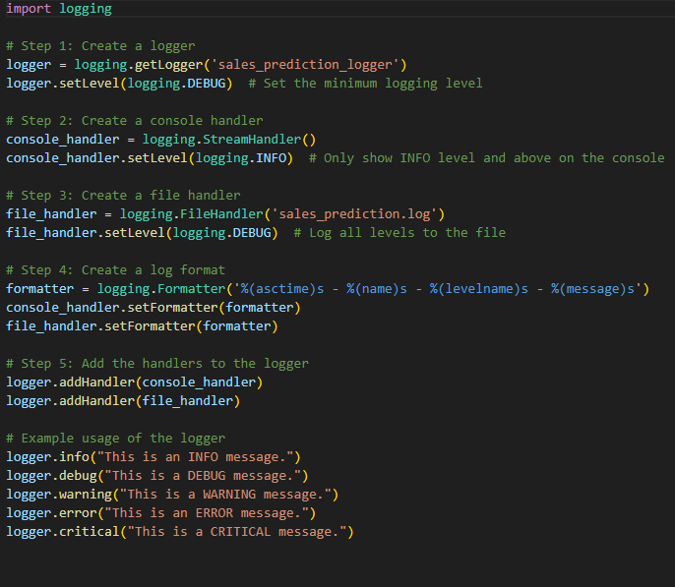
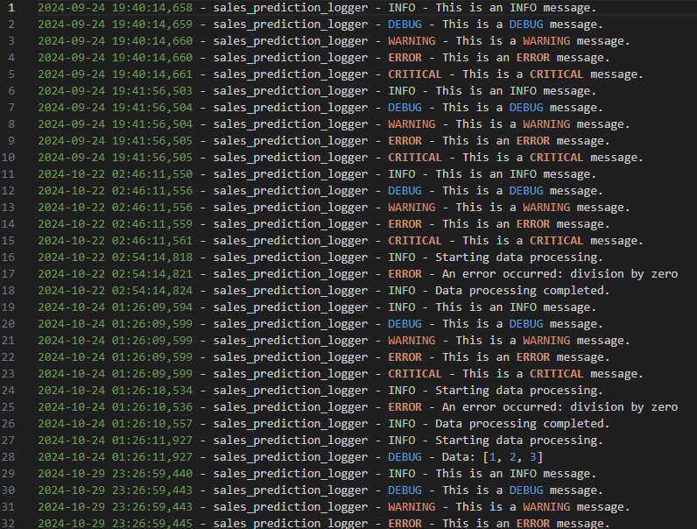
LOGGING
CREATED A LOGGER FILE CALLED sales_logger.py and the logs are saved in the file named sales_prediction_log

Slide 18
TASK 2 – PREDICTION OF STORE SALES
Prediction of sales is the central task in this challenge. you want to predict daily sales in various stores up to 6 weeks ahead of time. This will help the company plan ahead of time.
THE FUTURE PREDICTION OF SALES IS DONE AND THIS IS SAVED AS THE FILE NAMED “future_predictions_all_stores.csv”
The steps involved in the prediction of store sales include
1. Preprocessing
It is important to process the data into a format where it can be fed to a machine learning model. This typically means converting all non-numeric columns to numeric, handling NaN values and generating new features from already existing features.
In our case, you have a few datetime columns to preprocess. you can extract the
following from them: - weekdays, - weekends, - number of days to holidays
- Number of days after holiday
- Beginning of month, mid month and ending of month
- (think of more features to extract), extra marks for it
As a final thing, you have to scale the data. This helps with predictions especially when
using machine learning algorithms that use Euclidean distances. you can use the
standard scaler in sklearn for this.
ALL THESE PREPROCESSING WAS DONE AND CREATED A DATAFRAME CALLED “df_train”

Slide 19
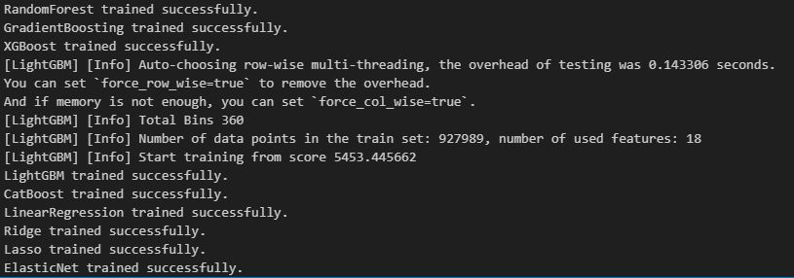
TASK 2 – PREDICTION OF STORE SALES
2. OUTLIERS REMOVAL: Outliers were removed and the dataframe named “df_filtered” was created.
3. BUILDING MODELS WITH SKLEARN PIPELINES – This was done successfully. Below is the output

Slide 20
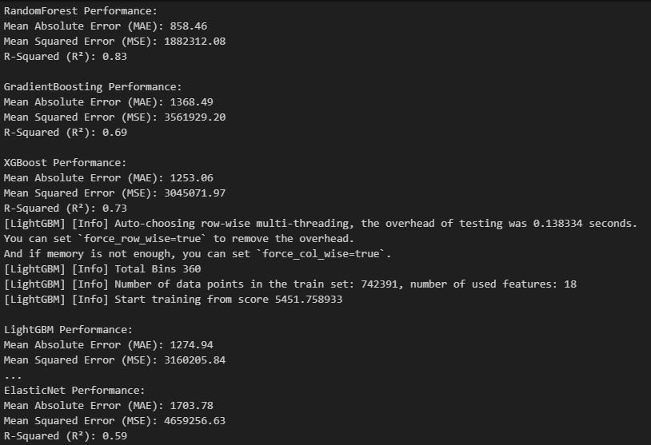
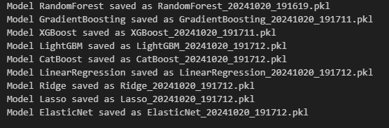
TASK 2 – PREDICTION OF STORE SALES
4. CREATE A PIPELINE FOR IMPUTING, SCALING AND MODEL FITTING AND ALSO ACCURACY CHECK
5. SERIALIZING THE MODELS
Best Fit:
Based on the metrics, Random Forest seems to offer the best fit due to its combination of low error rates and robust generalization, making it the most reliable model for predicting the satisfaction score in this context.

Slide 21
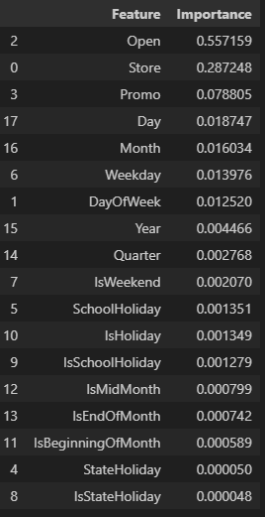
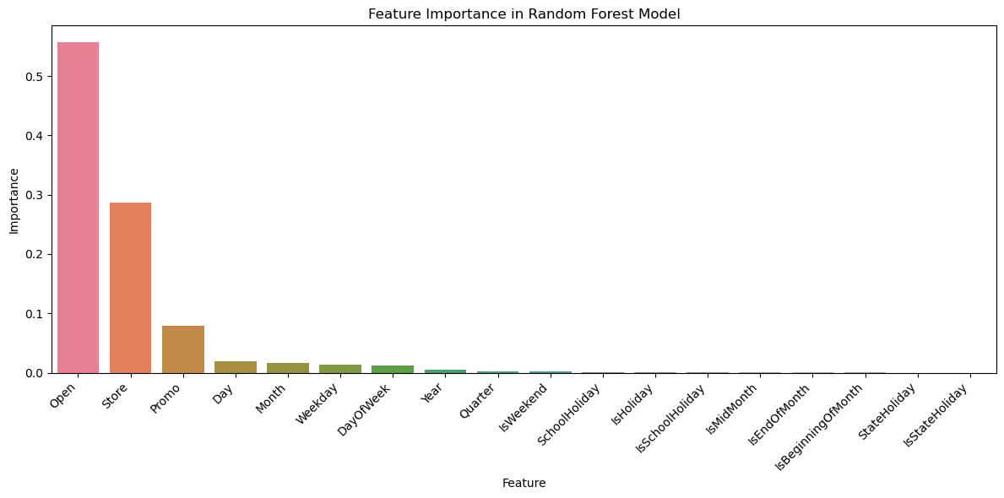
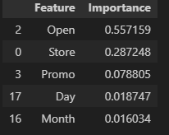
TASK 2 – PREDICTION OF STORE SALES
IDENTIFYING THE FEATURE IMPORTANCES

Slide 22
TASK 3 – BUILDING MODEL WITH DEEP LEARNING
# Step 1: Isolate the Rossmann Store Sales Dataset into Time Series Data
# Step 2: Check Whether Your Time Series Data is Stationary
ADF Statistic: -56.62430881041457 p-value: 0.0
INTERPRETATION:
1. ADF Statistic: As the ADF Statistic is negative, the more negative the ADF Statistic, the stronger the evidence against the null hypothesis.
2. p-Value: The p-value is 0.0 which is less than 0.05 indicates the strong evidence against the null hypothesis which means we can reject the null hypothesis
This means that the TIME SERIES DATA IS STATIONARY
Step 3: Depending on your conclusion from 2 above difference the time series data
There is no need of differencing the time series data as the time series data is already stationary.

Slide 23
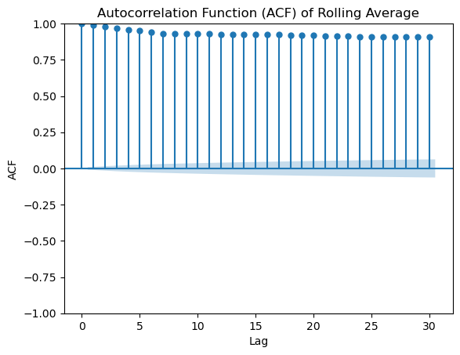
TASK 3 – BUILDING MODEL WITH DEEP LEARNING
Step 4: Check for autocorrelation and partial autocorrelation of your data
High autocorrelation at all lags: The ACF values are close to 1 across all lags and this indicates that the rolling average sales data is hightly autocorrelated.
Shaded confidence interval: All the autocorrelation points fall outside the region(blue shade), this indicates that the autocorrelations are significant for all lags and hence the sales data is not random but follows a structured pattern.

Slide 24
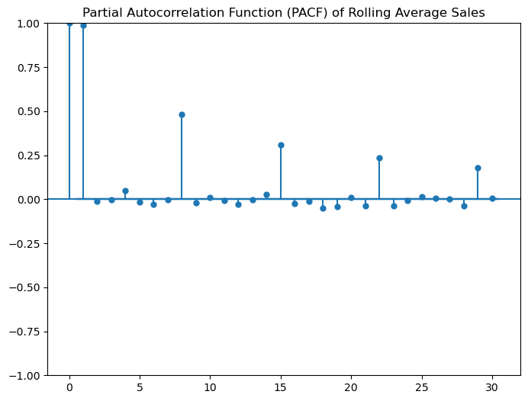
TASK 3 – BUILDING MODEL WITH DEEP LEARNING
Step 4: Check for autocorrelation and partial autocorrelation of your data
Significant lag at 1: The first lag shows a PACF value of nearly 1 indicating a very strong direct relationship between the current sales and the sales from one lag prior. This gives us a picture that the sales from the immediately preceding period have a very strong influence on current period.
Significant drop after lag 1: After lag 1 there is a drop in PACF value. This pattern suggests that the effect of sales data beyone one lag diminishes significantly after controlling for the effect of the first lag. this shows a typical behavior of autoregressive of order 1 where the current value is primarily dependent on the immediately preceding value.
Other Significant lags: There are notable lags at 10,15,and 25 but they are much smaller in comparison. These lags show some influence but are much weaker.
Non-significant lags: Most other lags fall within the confidence interval, indicating that the PACF at these lags are not statistically significant.

Slide 25
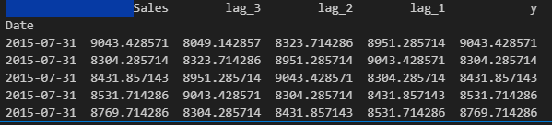
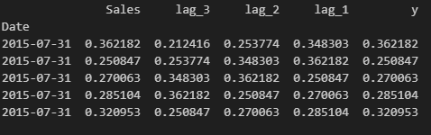
TASK 3 – BUILDING MODEL WITH DEEP LEARNING
Step 5: Transform the time series data into supervised learning data by creating a new y(target) column. For example as illustrated here in the Sliding Window For Time Series Data section
Step 6: Scale your data in the (-1, 1) range

Slide 26
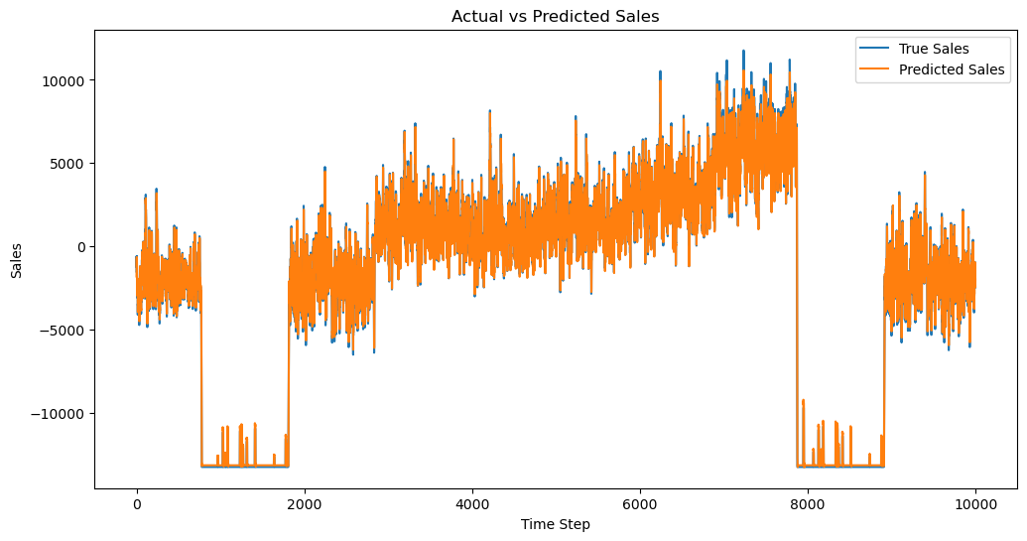

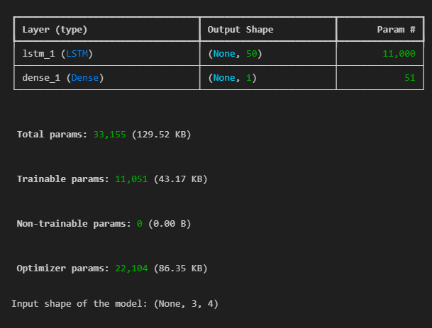
TASK 3 – BUILDING MODEL WITH DEEP LEARNING
AFTER THE TRAINING THE LSTM MODEL THE ACTUAL VS PREDICTED AS AS BELOW
CALCULATING THE METRICS
SUMMARY OF THE MODEL

Slide 27
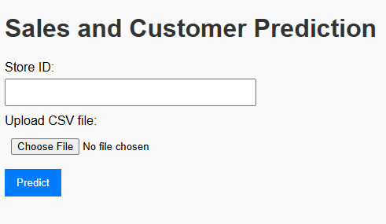
FINAL OUTPUT
When I run my app.py file in the terminal a web interface will be opened with the URL -- http://127.0.0.1:5000/
The screen shot of the appearing web interface is as below and it is designed as required in the project document i.e.,
The input fields in the frontend are for example
● Store_id
● Upload csv file with a columns name
○ Date
○ IsHoliday
○ IsWeekend
○ IsPromo
○ Any other parameter which is dependent on the date
Finally the dashboard should show a plot that shows the predicted sales amount and
number of customers. It should also allow the user to download the prediction in the
form of a csv table.

Slide 28
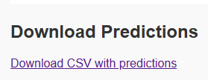
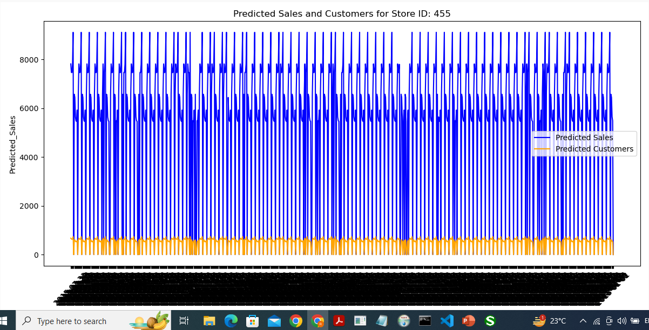
FINAL OUTPUT
When I run my app.py file in the terminal a web interface will be opened with the URL -- http://127.0.0.1:5000/
Finally your dashboard should show a plot that shows the predicted sales amount and number of customers. It should also allow the user to download the prediction in the form of a csv table.
When I enter the store id and when I upload the csv file containing the input features and press the predict button automatically a plot that shows predicted sales amount and predicted customers will be seen. Below is the screen shot of the output (the csv file I uploaded is “selected_columns_wi”) and an option to download the predicted sales in the form csv is also made.

Slide 29
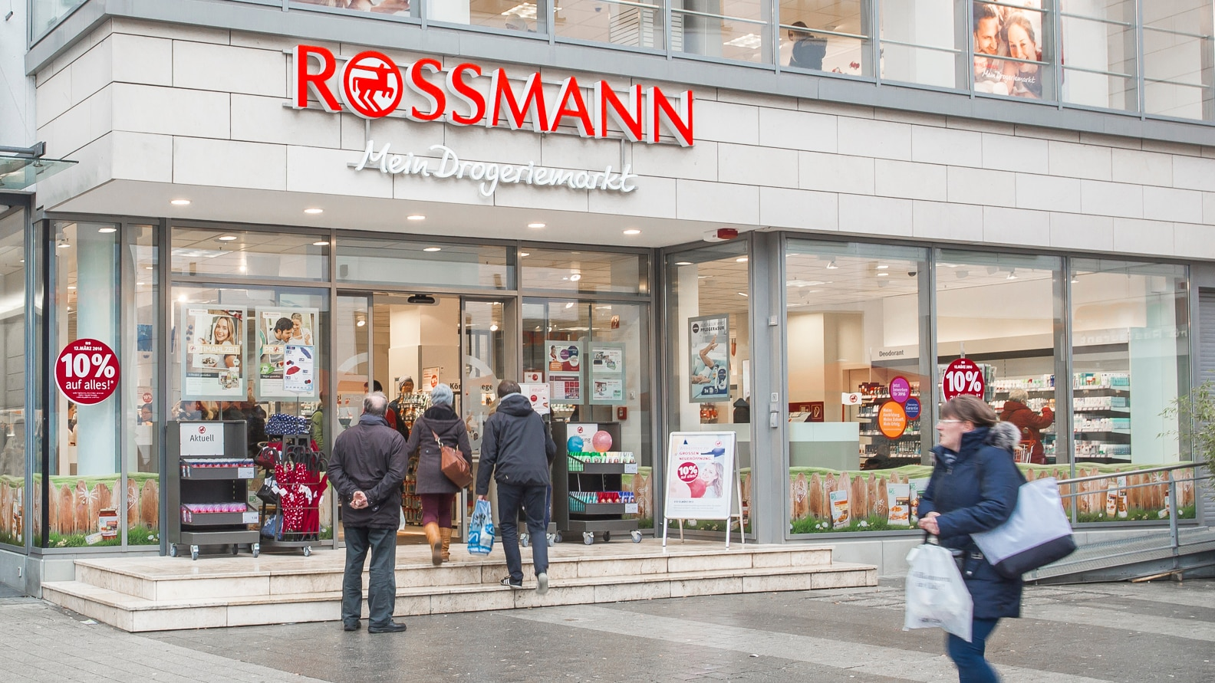
THANK YOU

